Slide 1
An introduction to Python for Bioinformatics
February 24, 2021 Parimala Devi Bioinformatician The Netherlands Cancer Institute

Slide 2
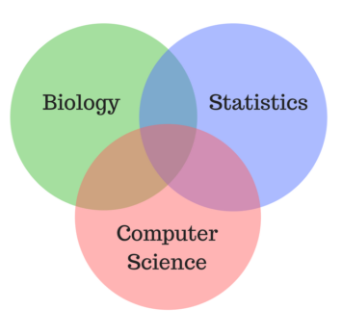
Introduction to Bioinformatics

Slide 3
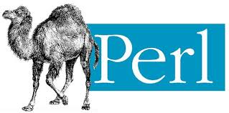


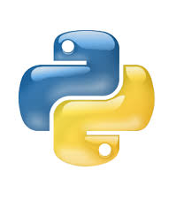


Common languages in Bioinformatics

Slide 4
Where to start?
New to bioinformatics as a programmer
New to programming as a biologist
Resources for the same
Get a “Bioinformatics in Python” book
Coursera course
Solve problems on Rosalind or Hacker Rank or Project Euler

Slide 5
Different fields in Bioinformatics
Precision medicine
Drug discovery
CRO
Clinical diagnostics

Slide 6
Any questions?

